Slide 1

Sales Data Analysis
and Reporting
for a Retail
Peseverance
Project ppt
Soumya K C丨KLS GIT Belagavi丨

Slide 2

Table Of Contents
01
Data Collection
02
Database Setup
03
Data Cleaning and Preparation
04
Data Analysis
05
Reporting

Slide 3

01
`
Data Collection and Database Setup
1.Data Collection: Download the data from Kaggle as a csv file and
place it on the proper path
2.Database Setup: Set up a SQL database to hold the data. Design
the database schema, and create the necessary tables using SQL
DDL commands.

Slide 4
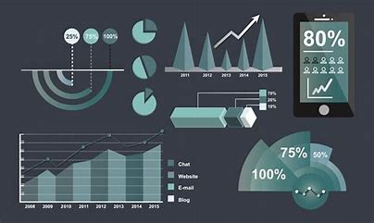
02
`
Data Cleaning and Preparation
Indexing: Indexed customer_id for faster queries.
Handling Missing Values: Set tran_amount to 0 for missing values.
Outlier Removal: Applied IQR method.
Date and Time Formatting: Ensured dates are in DATE/DATETIME format.

Slide 5
03
`
Data Analysis
Analysis Techniques:
Total Sales Calculation: Summing transaction amounts.
Customer Segmentation: Based on RFM metrics (Recency, Frequency, Monetary).
RFM Analysis: Classified customers into “Best,” “Loyal,” etc.
Churn Prediction: Identified inactive customers.
Cohort Analysis: Tracked customer retention.

Slide 6
03
`
Advanced Analysis
CLV and Churn Analysis: Explore models considering discount and retention rates.
Revenue Growth Analysis: Track trends over different periods.
Time Series Forecasting: Use ARIMA or Prophet for predictions.

Slide 7

04
`
Reporting
Reporting
Tabular Reports: Generated in SQL and formatted in Excel.
Visual Reports: Created using Python visualization libraries (matplotlib, seaborn).
Automated Reports: Regular updates with Python scripts.

Slide 8
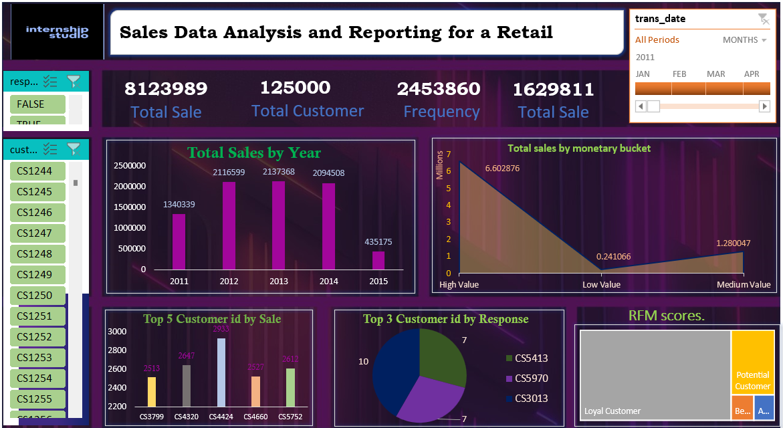
Excel Report

Slide 9
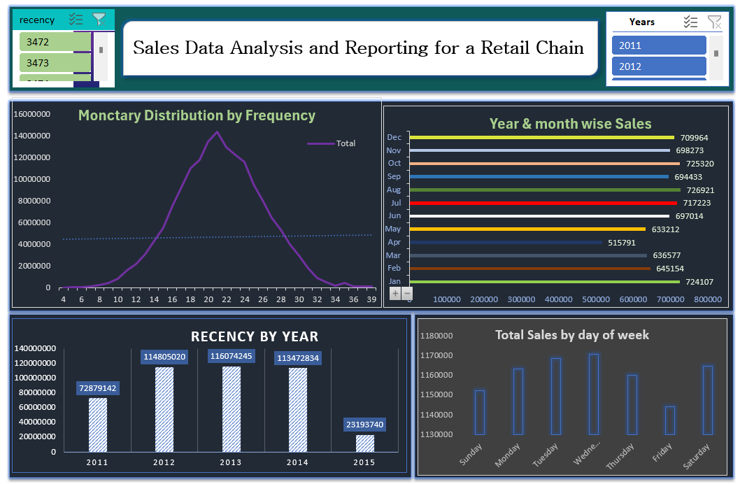
Excel Report

Slide 10
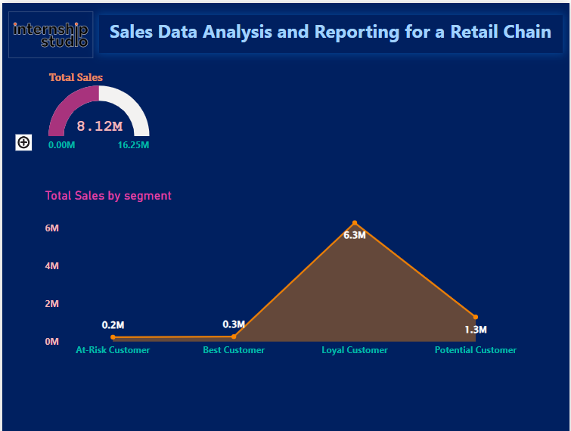
Power Bi Report
Press ctrl + Click
to view full Report

Slide 11
Power Bi Report

Slide 12


Peseverance
Soumya K C丨KLS GIT Belagavi丨
Thank you

